Slide 1
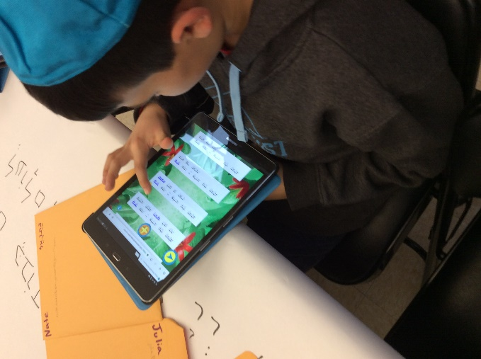
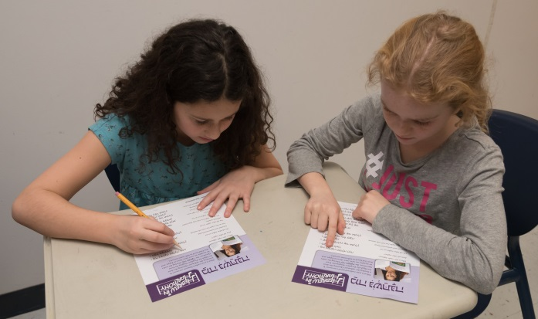
Hebrew in Harmony:
Teaching Prayer through Music
[school]
[city]

Slide 2
Topics:
1. Overview of Hebrew in Harmony
Why teach prayer through music
Musicians
Goals
Prayers included
3 components of each module
2. Lesson in action: Mi Chamochah
3. Digital demo
4. Some tips

Slide 3
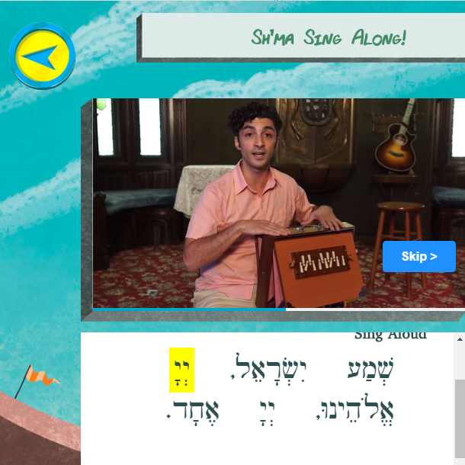
1. Overview of Hebrew in Harmony
Hebrew in Harmony is a Hebrew curriculum in which 4–6th graders learn prayer through music.

Slide 4
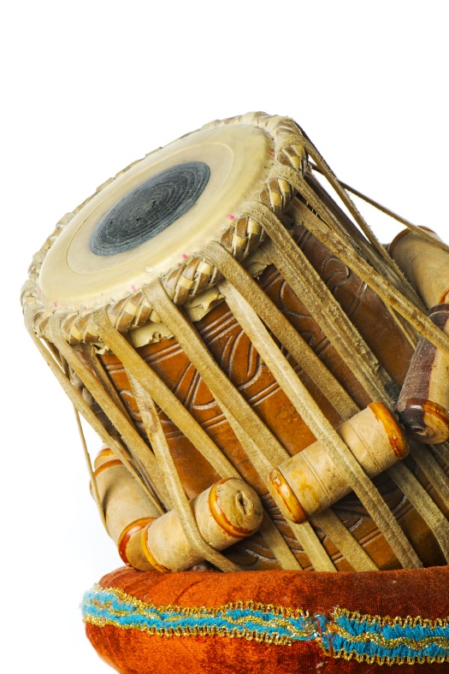
Why teach prayer through music?
Music is directly connected to emotions
Research shows cognitive benefits of music
Group singing is a powerful bonding experience, builds community (“singing together brings us together”)
Music allows the Hebrew words to flow
Music helps kids remember the words
Music is already a part of every child’s life
Notes:
Start with: “Tell us about an experience you’ve had that shows the power of music.”
Show this slide quickly, no need to read in depth.

Slide 5
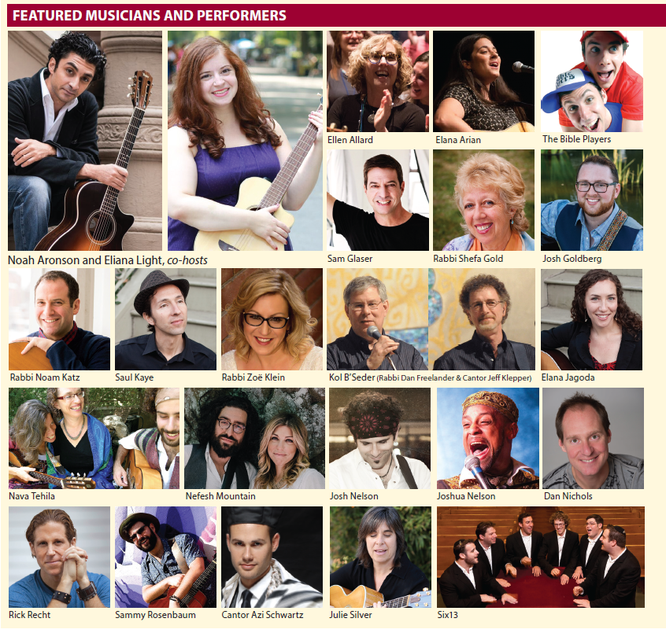
Notes:
Over 50 musicians’ included
2-3 songs per prayer module, including a traditional melody
Can upload your synagogue’s melodies into the app

Slide 6
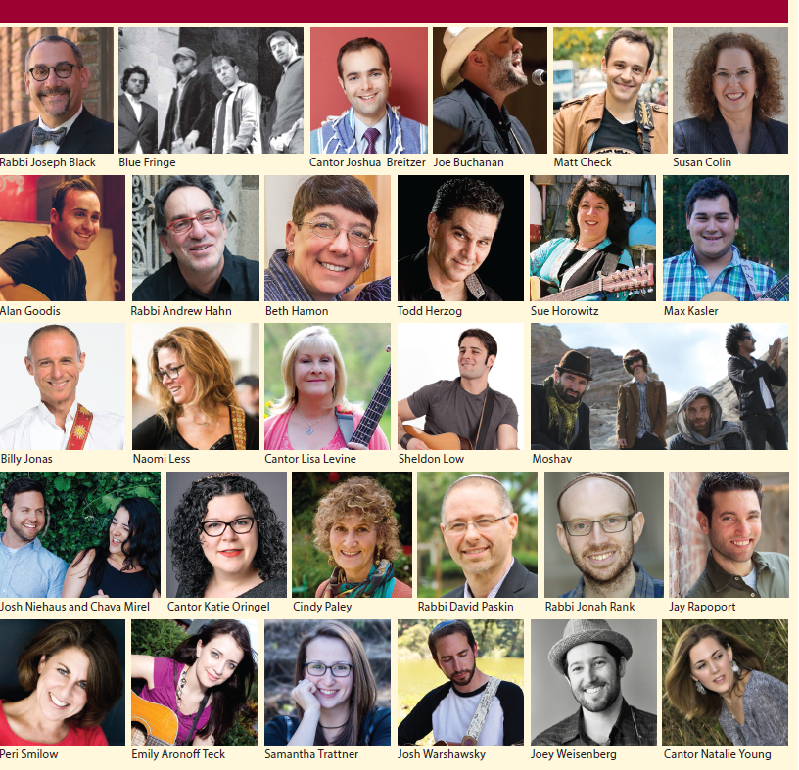

Slide 7
22 prayer modules available
Aleinu
Ashrei
Avot V’imahot
Bar’chu
Birchot HaHaftarah (incl Eitz Hayyim Hi)
Birchot HaTorah (incl Mi Shebeirach, V’zot HaTorah)
Birchot Shalom (Shalom Rav, Sim Shalom, Oseh Shalom)
B’rachot
Ein Keloheinu, Adon Olam
G’vurot
Hotza’at HaTorah
Havdalah
Kaddish
K’dushah
Kiddush
L’chah Dodi
Ma’ariv Aravim, Yotzer Or
Mah Nishtanah
Mi Chamocha
Shalom Aleichem
Sh’ma
V’ahavta
Notes:
Educators choose the prayers that fit their curriculum. Usually do 4-5 prayers a year.
You can tell your teachers the prayer modules YOU will be using in each grade.

Slide 8
Goals
Students will:
Engage with prayer intellectually, emotionally, and spiritually
Experience prayer through multiple modalities (music, movement, art, digital learning, and mindfulness)
Find meaning in praying as a community
Learn prayer Hebrew skills
Notes:
Primary goal is to make meaning of prayer while learning prayer skills.
(Spend little time on this slide.)
Detailed goals for each module are here: https://store.behrmanhouse.com/index.php/hebrew-in-harmony-aleinu.html
(see “About Hebrew in Harmony” tab)

Slide 9
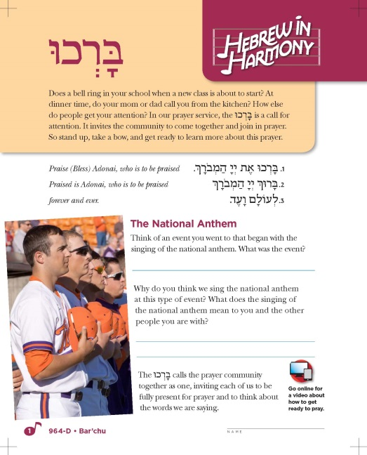
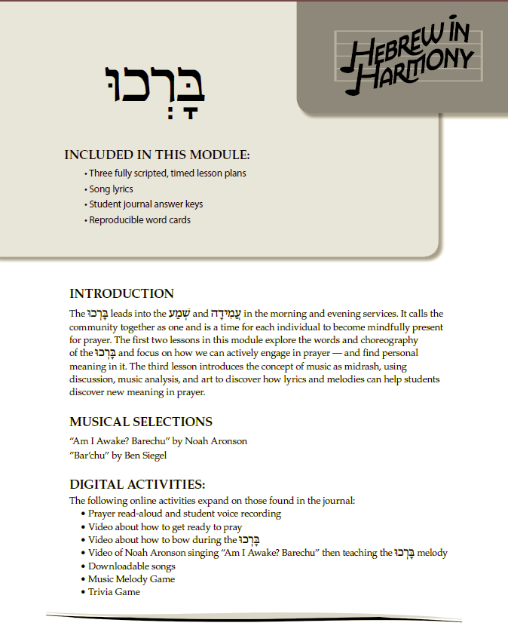
3 components in each module/prayer
1
16-page student journal
2
Digital companion
3
Curriculum Core
Notes:
The student journal is enriched by the digital companion. They go hand in hand. Digital is integral, essential.
Journal used in class.
Digital used in class together or in stations (or at home especially when kids are absent).
Curriculum fully scripted—3 lessons per prayer module. Pick the activities that suit you.

Slide 10
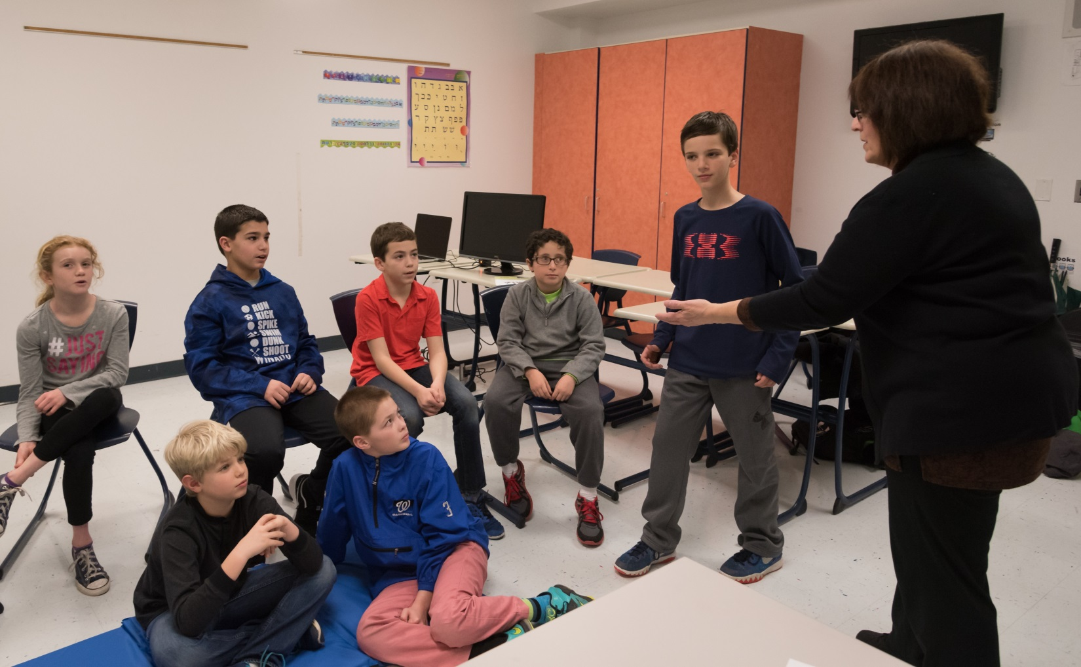
2. Lesson in Action:
Mi Chamochah
Notes:
Just a sampling of activities from one lesson. Everything we say here is in the Curriculum Core. Show Mi Chamochah in CC.
Consider having your teachers present an activity of their choice. Key is for them to see/experience the variety of modalities, how it’s all in the CC, etc.
Consider having them role play activities together. Key is to get them engaged.

Slide 11
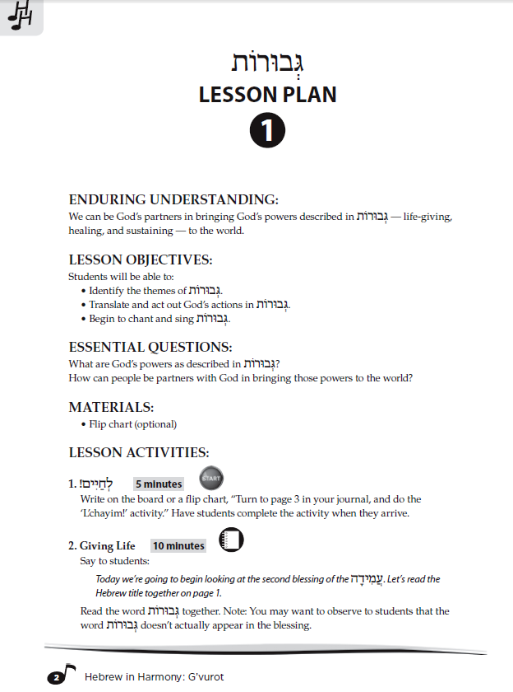
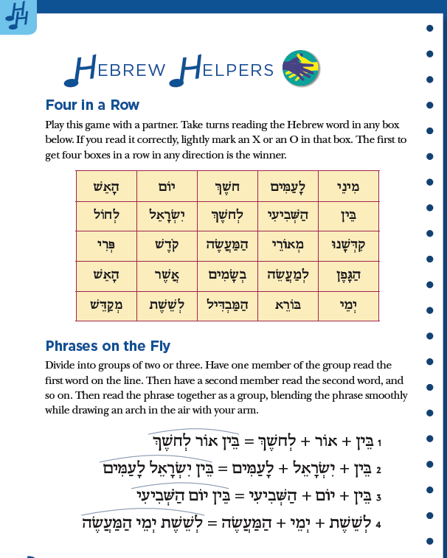
For each prayer, the Curriculum Core gives 3 lessons of 50–60 minutes each.
Each activity is fully scripted with amount of time. Expand or reduce as you choose.
The journal is divided into 3 lessons.
“Hebrew Helpers” ends each lesson in the journal.

Slide 12
1. Do the “Start” Activity
Turn to page 3 in your journal and complete the “It’s a Miracle” activity.
Notes:
These are components of a typical lesson. All drawn from the CC.
Have teachers look at Mi Chamochah CC lesson plans.
Each lesson begins with a Start activity that kids do when they come into class. You write it on the board. Draws the kids into the new material. Relates new material to their own lives.

Slide 13
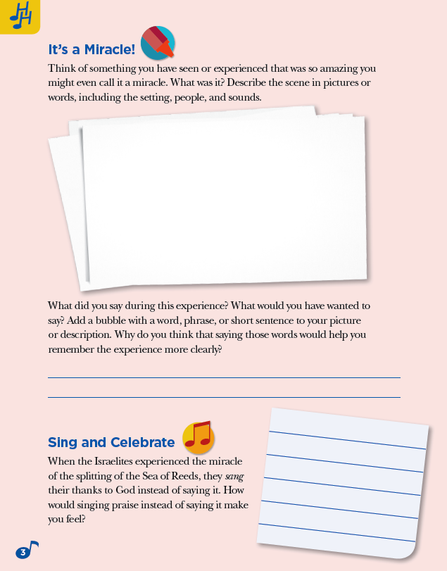
Notes:
Look in your own journal, page 3 (can work through it together). The CC tells you what to do.

Slide 14
2. Get out of your seats
“Word/phrase from your amazing experience”
“Word/phrase: You just crossed the Sea of Reeds!”
Notes:
Out of your seat activity:
Put 2 large post its or poster board cut out in the shape of a word bubble.
“Come up and write the word/phrase you said during your amazing experience.”
Then relate their personal experience to the Israelites’ crossing the Sea of Reeds. How do you think the Israelites reacted?

Slide 15
3. Read the prayer
Notes:
Now that you’ve introduced the concept/background/theme, and connected it to their own lives, they turn to the prayer, read the introduction, and then the prayer.

Slide 16
4. Learn the Hebrew
Roots
Notes:
A typical Hebrew activity from the journal

Slide 17
5. Find meaning through the music
Notes:
Play Joshua Nelson’s Mi Chamochah from the digital app

Slide 18
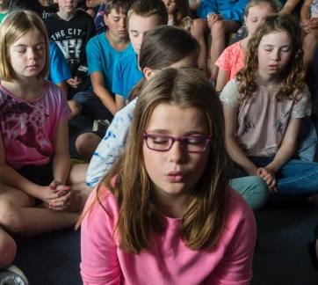
6. Do a mindfulness activity, followed by art representing the scene they imagined
1.
2.
Notes:
You ask students to imagine they have just crossed the Sea of Reeds. Script is in CC, page 5. Try it together! Then you supply art materials and they draw/create the scene they imagined.

Slide 19
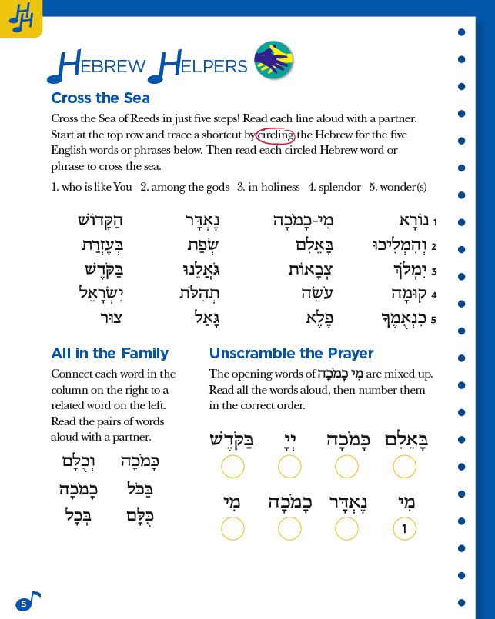
7. End the lesson with “Hebrew Helpers”
Notes:
Students practice and enrich the Hebrew they learned during this lesson.
Each journal has THREE Hebrew Helpers pages. They divide up the journal into the 3 lessons as shown in the Curriculum Core.

Slide 20
8. Do a wrap-up/review before students leave
Notes:
Quick summary, short answers, quick review at end of lessons. Ideas are in CC.

Slide 21
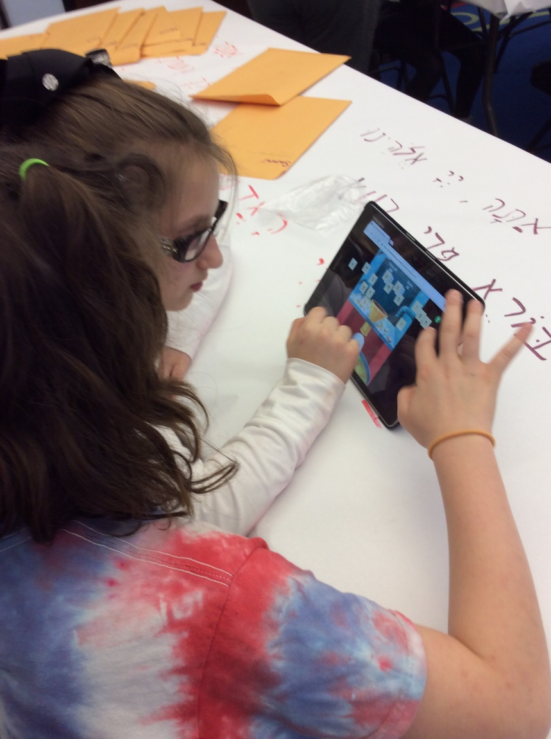
9. Go to the digital companion
Notes:
Usable on all devices in web browsers and also as a native iOS app (iPads and iPhones).
HOW TO ACCESS
Option 1: On a device
Download the app from the App Store. Students log in using their Online Learning Center* email and password. This associates the user with the license.
Option 2: On a computer
1. Go to www.behrmanhouse.com/playlearn
2. Log in using the email address and password created by the school
3. After logging in, you will see the learning app.
*OLC registration lets you track student work in Hebrew in Harmony.

Slide 22
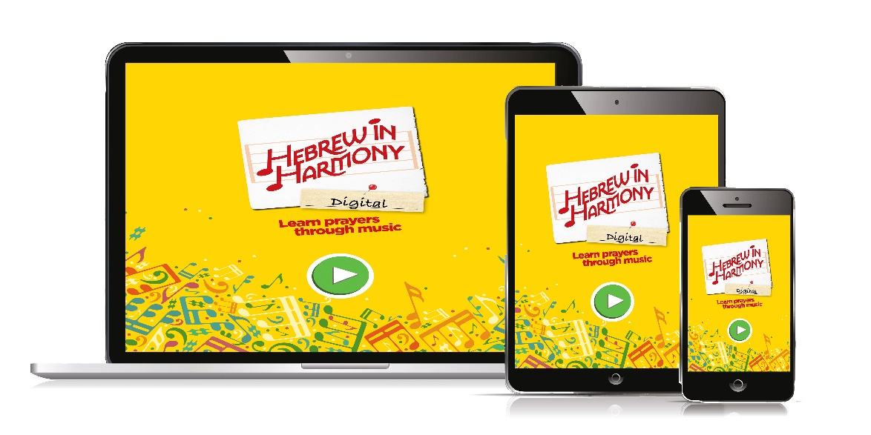
3. Digital demo
Notes:
HOW TO INTEGRATE INTO YOUR LESSONS
The Hebrew in Harmony app can be used on any device – tablets, smartphones, or computers.
Play the music in class. All the music is in the app. The music drives Hebrew in Harmony—play it with strong speakers in class! Then have students complete the matching journal activities.
Watch the videos. Hook up a laptop, projector, and speakers and show the videos to the entire group. Or have students access the videos on their individual devices.
Build in plenty of time. Students will benefit the most if they have plenty of time to access the app—whether in individual, small-group or at-home practice—ensuring they can take full advantage of all the features, such as recording themselves reading the prayers, and having teachers review student work.

Slide 23
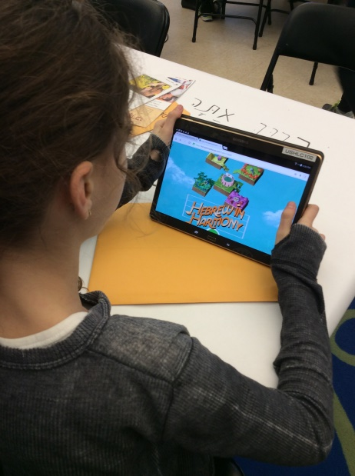
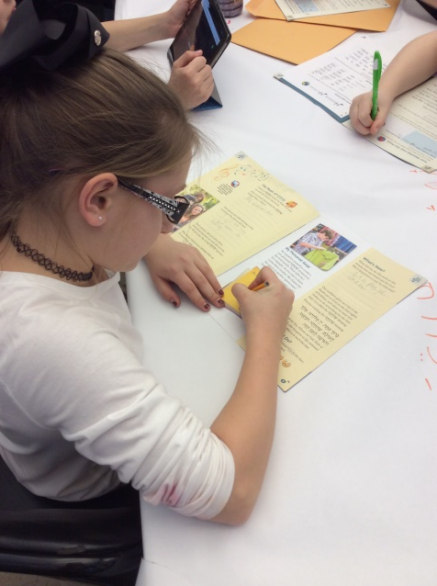
4. Some tips
Plan carefully
Use the journals purposefully
Differentiate your teaching; learn individually, pairs, whole group
Show kids how use the digital
Ensure you have strong wi fi!
Notes:
PLAN: Review the lessons in the CC in advance, choose the activities you want, decide how much time to devote to each. Get the technology set up and test it. Consider using a laptop, projector, speakers to show the videos. Students use the app alone or in pairs on devices. Print out song lyrics in advance.
JOURNALS: Activities in the journal are tied to the CC. Assign the journal carefully and purposefully. Review in pairs or as a group.
DIFFERENTIATE: Students have preferred ways of learning. Write in journal, draw. Movement, some like to talk. IF kids are uncomfortable expressing their feelings, let them listen first and join in later. Meet them where they are comfortable, e.g., talk about sports or music or popular culture. Push them just a little bit e.g., with mindfulness activities. Affirm them for trying. Let kids work at stations but always gather together, e.g., for group discussion, to watch the videos together.
DIGITAL: Show students how to sign in to the app on devices using their OLC credentials.

Slide 24
customersupport@behrmanhouse.com
Join the Hebrew in Harmony Facebook group:
www.facebook.com/groups/HebrewinHarmony/

