Slide 1
Hospitality
Hakhnasat Orhim
הַכְנָסַת אוֹרְחִים
© 2011 Behrman House/Babaganewz

Slide 2
Hospitality הַכְנָסַת אוֹרְחִים
We perform this mitzvah by welcoming guests to our homes, synagogues, schools, and neighborhoods.
Even nations have an obligation to welcome strangers. Throughout history, Jews have known what it’s like not to be welcomed where they live. We know how hard it is, and we don’t want others to feel that way.
© 2011 Behrman House/Babaganewz

Slide 3
Who Cares About Everyone Else?
What are some ways that we can fulfill the mitzvah of hospitality as an individual?
What are some ways that we can fulfill the mitzvah of hospitality as a Jewish nation?
What special responsibilities do Jews have to make people feel welcome?
© 2011 Behrman House/Babaganewz

Slide 4
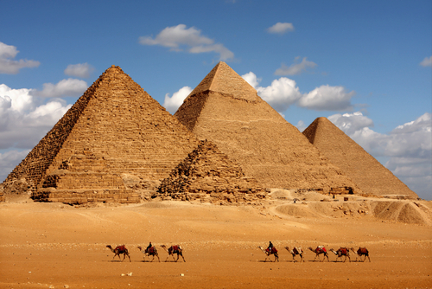
You shall not taunt or oppress a stranger, for you were strangers in the land of Egypt. (Shemot 22:20)
We weren’t just strangers in Egypt, we were slaves. Is that the same thing as a stranger?
Why should this experience in Egypt influence our behavior in terms of welcoming strangers?
How is being a stranger in a foreign land similar to and different from being a guest in someone else’s house?
© 2011 Behrman House/Babaganewz

Slide 5
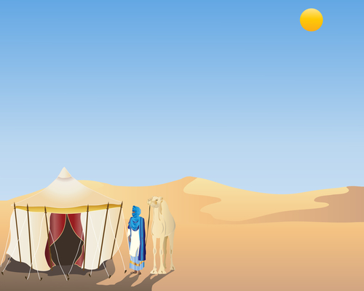
And [Avraham] lifted up his eyes and looked, and, behold, three men stood by him. And when he saw them, he ran to meet them from the tent door, and bowed toward the ground. And he said…”Let a little water be brought that you may wash your feet and rest yourselves under a tree. I will bring a bit of bread so that you may comfort your heart….” (Bereishit 18:2-5)
Abraham ran to meet his guests and treated them like kings. What does this teach us about how we should treat visitors?
Has anyone every run to greet you? How did it feel?
When someone comes to your door, how do you welcome them?
© 2011 Behrman House/Babaganewz

Slide 6
Receive all people with a cheerful face. (Pirkei Avot 1:15)
Do you think that this verse is talking about hospitality? Why or why not?
How can there be hospitality with no food or drink either mentioned or implied?
Can a mere smile, offered on the street or in a public place, also be a form of hospitality?
© 2011 Behrman House/Babaganewz

Slide 7
Do not be scornful of any person and do not be disdainful of any thing, for there is no person without his or her hour and no thing without its place. (Pirkei Avot 4:3)
How should we treat each of our guests?
What if we aren’t friends with or don’t like one of our guests?
What do you think it means here that there is no thing without its place?
© 2011 Behrman House/Babaganewz

Slide 8
How do you practice hospitality?
© 2011 Behrman House/Babaganewz

Slide 9
Be Our Guest
Watch the video:
© 2011 Behrman House/Babaganewz

Slide 10
Belle’s Welcome
What are all the ways that Lumiere and the others welcome Belle?
What does it mean to say “we only live to serve”?
How do you think it would feel to be welcomed like Belle was welcomed?
© 2011 Behrman House/Babaganewz

Slide 11
Welcome Wagon
Turn your classroom into Avraham’s tent and welcome in your parents or another class.
Craft a “Welcome” sign to post by the door.
Show your guests hospitality with kind words and friendly faces.
Try to give your guests as many different things as possible, while sticking to who you are and what you want to do.
© 2011 Behrman House/Babaganewz

