Slide 1
Learning Torah, Talmud Torah
תַּלְמוּד תּוֹרָה

Slide 2
Talmud Torah, Learning Torah
Just as Torah is the basis of Israel's covenant with God, talmud Torah is a means of cementing that bond and of providing communal uplift.
Learning Torah is an affirmation of our spiritual vitality.
Insights gained through the continuous learning of Torah give meaning to life.

Slide 3
Activator
Brainstorm as a class why you think Torah study is considered the most important of all the mitzvot (commandments).

Slide 4
“There are 70 facets to the Torah.” (Bemidbar Rabbah 13:15)
What is a facet? What do you think it means that there are 70 facets to the Torah?
How does this concept enhance your understanding of what it means to study Torah?

Slide 5
“One who honors Torah is honored by all of God’s creations.” (Pirkei Avot 4:6)
Do you think this text refers to the Torah scroll or to the teachings of the Torah? Explain.
Why is a person who honors the Torah worthy of receiving honor from all humankind?

Slide 6
“What is the meaning of the verse: “[The Torah] is not in the heavens, nor is it across the sea” (Devarim 30:12)?...If it were in the heavens, you would have to go up after it, and if it were across the sea, you would have to cross the ocean to reach it.” (Eruvin 55a)
For what might the heavens and the sea be a metaphor?
What is this text trying to teach us?

Slide 7
“You shall contemplate it [the Torah] day and night.” (Joshua 1:8)
What does this mean to you?
In what ways do you incorporate Torah study into your daily life?

Slide 8
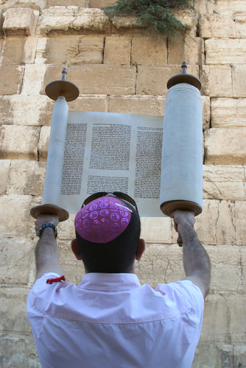
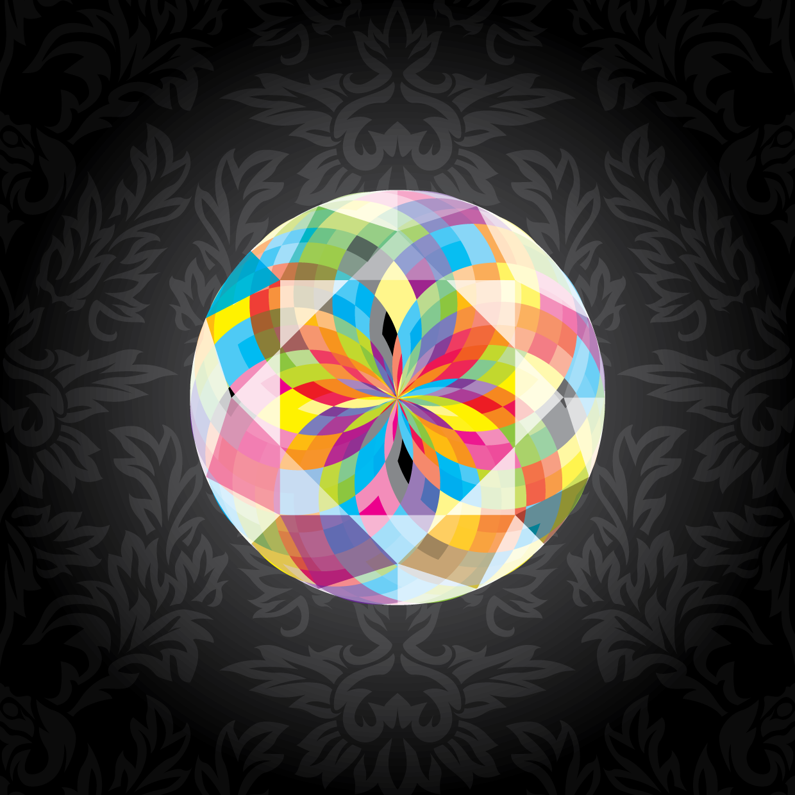
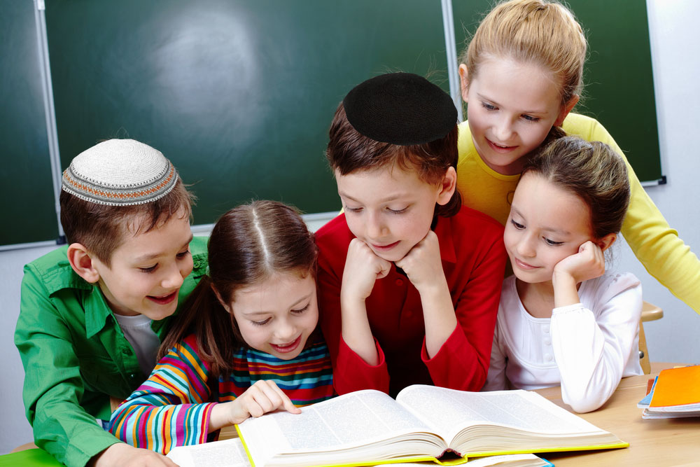
Describe what these images remind you about talmud Torah, learning Torah.

Slide 9
Listen to “Turn It” by Mah Tovu and follow along with the lyrics.
Again and again, for everything is
in it
Turn it, turn it, turn it again
It’s not up in the heavens so that
someone has to say
“Who will bring it down for us to
do and hear today?”
The Torah is so close, it’s in your
mouth, it’s in your heart
But knowing that it’s near is just the start
Study by itself is not enough for us to do
Acting on these teachings is what
it means to be a Jew
Learning it and doing it are two
halves of a whole
Living Torah, being Torah, this is our true goal
You’ve got to…
Chorus
Ha-foch ba, va-ha-foch ba d’cho-la ba
Turn it over and over again
Ha-foch ba, va-ha-foch ba d’cho-la ba
Turn it over and over and over and over
And over and over again
Chorus
The Torah is our life, it is the
length of our days
Its lessons still inspire us in so many ways
So if you’ve got a question, open
up and take a look
After all, we are the people of the book
From how to love your neighbor
To the way we treat the poor
The proper way to hang your new
mezuzah on the door
Honoring your parents, how to
hear the shofar’s sound
By peeling back the layers any
answer can be found
You’ve got to…
Chorus:
Turn it, turn it
Again and again, for everything is
in it
Turn it, turn it, turn it again
Turn it, turn it

Slide 10
What Do You Think?
What do you think the phrase, “Turn it [the Torah], turn it, for everything is in it,” means for Torah study?
When and in what ways do you learn Torah and do Torah?
If you were writing a song about your connection to talmud Torah, what would be its focus?

Slide 11
Faces of the Torah
Let’s revisit the text from Bemidbar Rabbah 13:15 that reads: “There are 70 facets to the Torah.” Show how your understanding of this text has been enhanced and what it means to you. Choose a project from the following menu and showcase your creativity and personal connection to Torah study!
Drawing
Song
Poem (see this link for various poetic forms: http://babaganewz.com/teachers/poetic-forms)
Skit with friends
Graphic organizer
News article based on interviews with classmates

