Slide 1
Ahavat Eretz Yisrael אַהֲבַת אֶרֶץ יִשְׂרָאֵל
Love of the Land of Israel

Slide 2
Definition of ahavat eretz yisrael
The Jewish people have always felt a deep connection and love for the land of Israel. This love began with God’s promise to Avraham to give the land to him and his descendants, and continues as the Jewish people rebuild the land of Israel today.

Slide 3
Questions about Ahavat Eretz Yisrael
When you think about the land of Israel, what are the first associations that come to your mind? Each student shares one word which they associate with Israel.
What places in Israel, if any, do you feel particularly connected to? Why?
Why do you feel as you do toward Israel? What have you experienced or done that has shaped how you feel toward Israel?

Slide 4
Land of Israel – Center of the World
“Just as the navel is placed at the center of the human body, so too is the Land of Israel placed in the center of the world.” (Tanhuma Kedoshim 10)
What does it mean for the land of Israel to be the center of the world?
What places are the center of your world? Is the land of Israel a center for you? Why or why not?

Slide 5
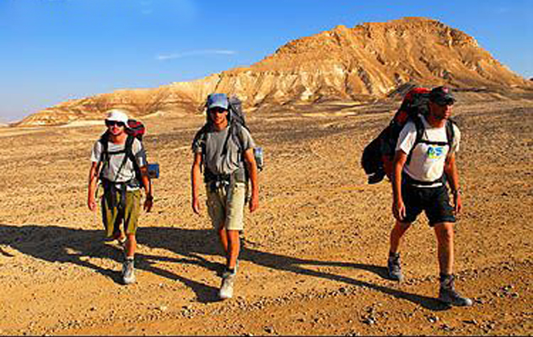
Walking the Land
“Get up and walk the land, through its length and its breadth, for I give it to you.” (Bereishit 13:17)
Soon after Avraham arrives in Israel, God commands Avraham to walk throughout the land. Why?
How can walking the land help you connect to it?
If you have walked, hiked, or biked in Israel, how did it make you feel about the land?

Slide 6
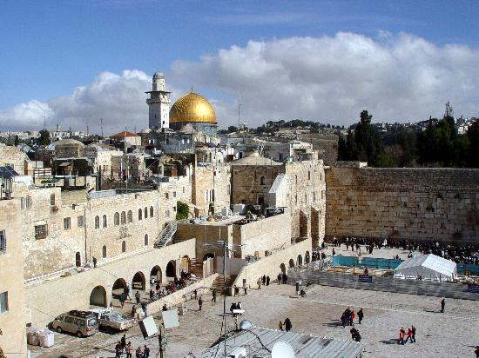
History of the Land
“Our hope is not yet lost, the hope of two thousand years, to be a free people in our land, the land of Zion and Jerusalem.” (Hatikvah, Israel’s national anthem)
What is the people of Israel’s historic connection to the land of Israel?
Why and how did the Jewish people maintain their connection to the land of Israel throughout two thousand years in the Diaspora?

Slide 7
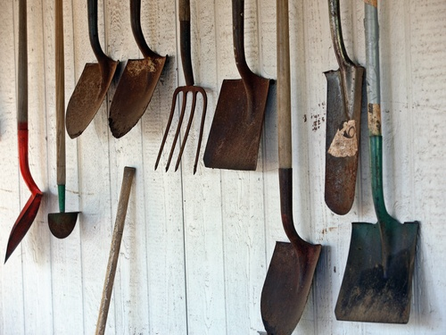
Protecting the Land
“But the seventh year shall be a Sabbath of solemn rest for the land, a Sabbath for God; you shall neither sow your field nor prune your vineyard.” (Vayikra 25:4)
Why is it important to let the land rest?
Why is a Sabbath for the land a Sabbath for God?
This verse describes shemittah, one of the mitzvot that only applies in the land of Israel. Why do you think this mitzvah only applies in Israel?

Slide 8
Describe what these images show you, what they remind you of, or how they make you feel.

Slide 9
Eretz Yisrael Sheli Yafah
“My land of Israel is beautiful and blooming. Who built it and planted it? All of us together.”

Slide 10
The video includes many images of the land of Israel. What are some of them? Which images do you connect to most?
The video uses an Israeli children’s song, “Eretz Yisrael Sheli Yafah.” The chorus means, “My land of Israel is beautiful and blooming. Who built it and planted it? All of us together.” What does it mean that together we built the land? What are some of the ways someone can build the land?
How do we relate to the land differently if we build it ourselves?
What can you and your classmates do to build the land of Israel?

Slide 11
My Israel
Each student draws or finds an image on the Internet that represents his or her connection to the land of Israel, and writes a caption–a word, a few prose sentences, or a short poem. Students get together in small groups to present their images and explain how those images represent their connection to the Land of Israel.

