Slide 1
Mutual Responsibility
Areyvut
עֲרֵבוּת
© 2011 Behrman House/Babaganewz

Slide 2
Mutual Responsibility עֲרֵבוּת
Jews have a responsibility to one another; to our communities, to our synagogues, to our towns, and to other Jews. When we have the ability to help someone else, it is not just a “nice thing to do,” it’s our responsibility.
© 2011 Behrman House/Babaganewz

Slide 3
Thought Question
What do you think it means for Jews to be responsible for each other?
Why do you think we need this as a Jewish value?
What part of the Jewish community do you feel responsible for?
© 2011 Behrman House/Babaganewz

Slide 4
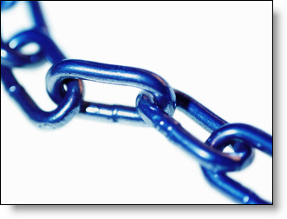
All of Israel is responsible for one another. (Shevuot 39a)
What does it mean that “all of Israel” is responsible?
Have you ever had an experience where you have felt responsible for the actions of someone else?
What is it like for you to be connected to other Jews in this way?
© 2011 Behrman House/Babaganewz

Slide 5
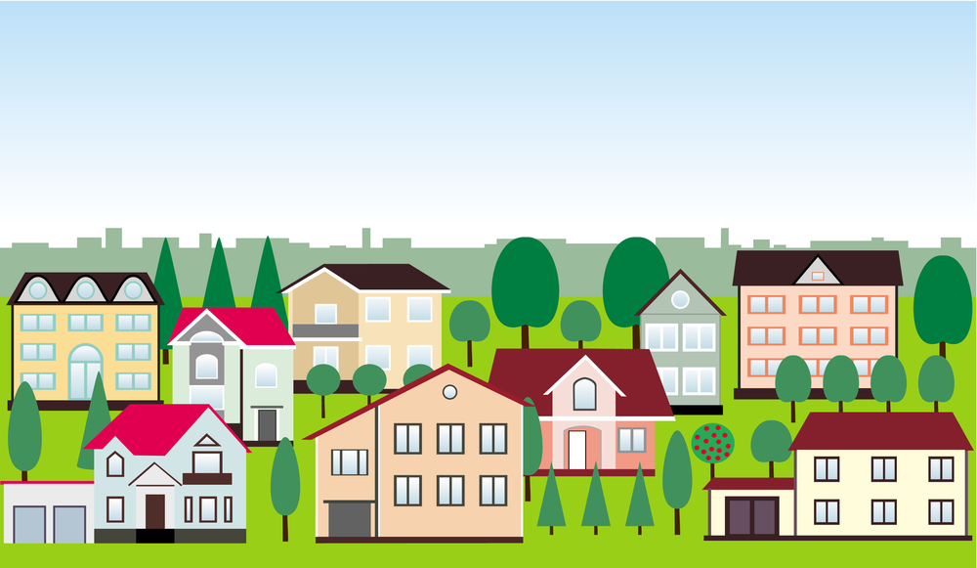
A Talmud scholar is not permitted to live in a city that does not have the following: a court empowered to punish the guilty, a communal tzedakah fund—monies which are collected by two people and distributed by three, a synagogue, a mikveh, sufficient bathroom facilities, a doctor, a bloodletter (i.e., a popular healer), a scribe, a butcher, a Torah teacher for children.
(Sanhedrin 17b)
Why do you think the Talmud wants us to live in cities with all of these things?
Which things on this list would go under the category of mutual responsibility?
Would you add anything to this list? If so, what would you add and why?
© 2011 Behrman House/Babaganewz

Slide 6
Our brothers [and sisters], the entire house of Israel, who are delivered into distress and captivity, …may God have mercy on them, and remove them from distress to relief, from darkness to light, …And let us say, Amen. (Weekday Shaharit, Torah Service)
According to this prayer, how are we related to other Jews?
What are some ways people today might be “in distress” or “captivity”?
Here we pray for God to deliver Jews who are in trouble. What are additional ways we can help people who are in trouble?
© 2011 Behrman House/Babaganewz

Slide 7
“You are not obligated to complete the task; nevertheless you are not free to leave it.” (Pirkei Avot 2:20)
Why is it important to keep working at a task even when you will not be able to complete it?
How does a person know when it’s okay to stop doing a job that isn’t yet finished?
Have you ever had to finish a job that someone else started? How was it?
© 2011 Behrman House/Babaganewz

Slide 8
So what IS your responsibility?
© 2011 Behrman House/Babaganewz

Slide 9
Watch this video:
© 2011 Behrman House/Babaganewz

Slide 10
Discuss:
When you come to a new place, do you seek out the Jewish community? Would you turn to the Jewish community for help or support if you were traveling and needed something?
Do you feel connected to Jews in other parts of the world? Does this connection motivate your actions in any way?
© 2011 Behrman House/Babaganewz

Slide 11
Making Priorities
Go around the room and brainstorm possible situations or circumstances in your community in which you can connect to and help fellow Jews.
Using the idea of mutual responsibility as your guide, as a group rank these ideas in order from most important to least important.
© 2011 Behrman House/Babaganewz

